Slide 1
Enhancing ORB-SLAM2 with Monocular Cameras through Computed Depth Information
16-833 Robot Localization and Mapping
Zach Esakof, Connor Geshan, Jhanak Johri
Notes:
Main title: 40 pt. Arial
Presenter Name: 16 pt. Arial
Presenters Title: 16 pt. Arial Italic

Slide 2
Motivation
Background
Methodology
Results
Remaining Work

Slide 3
We seek to improve the accuracy and efficiency of monocular ORB-SLAM2 by adding depth estimation for monocular images

Slide 4
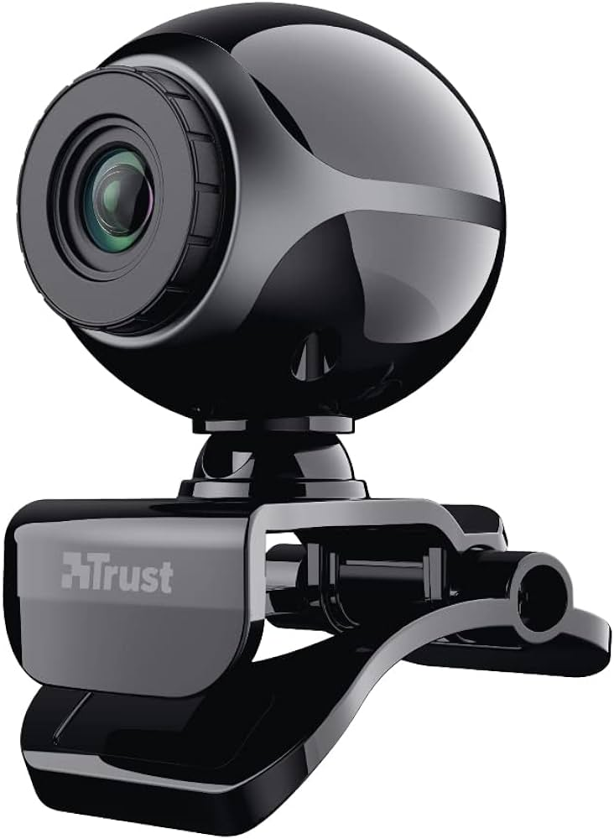
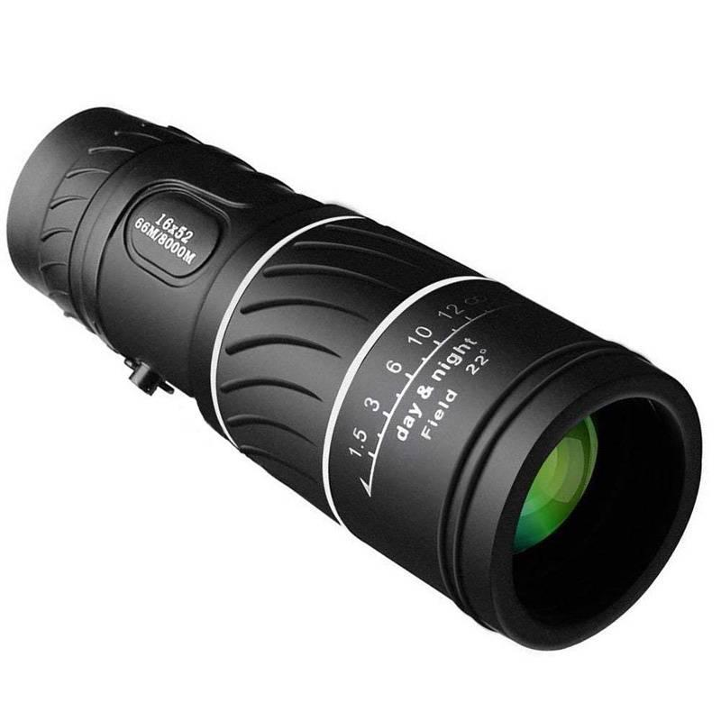
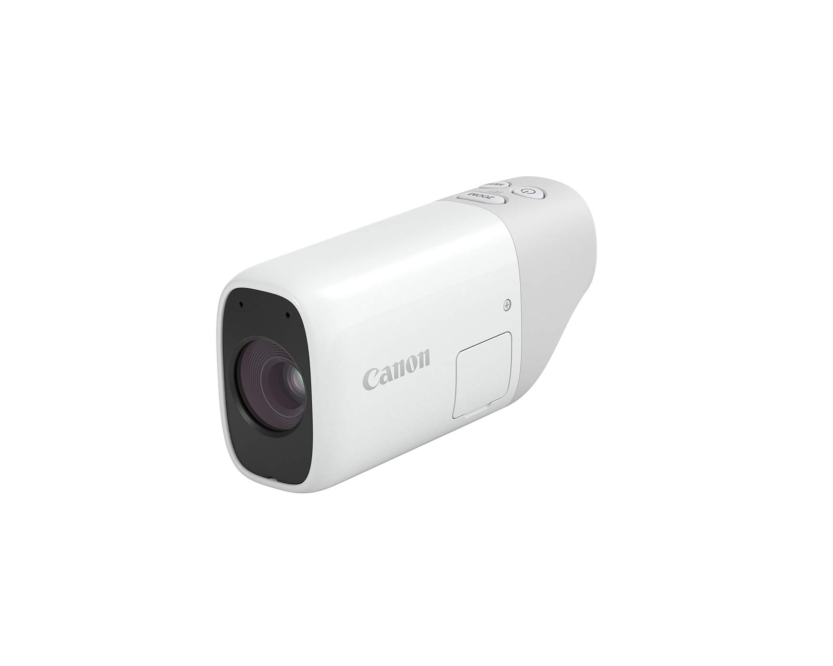
Monocular cameras are cheap and ubiquitous options in robotics
Notes:
Monocular cameras are cheap and ubiquitous, but less efficient at depth estimation than cameras that use lasers (RGB-D) or multi-camera arrays (stereo).
Classical approaches require multiple monocular images before depth information is available.

Slide 5
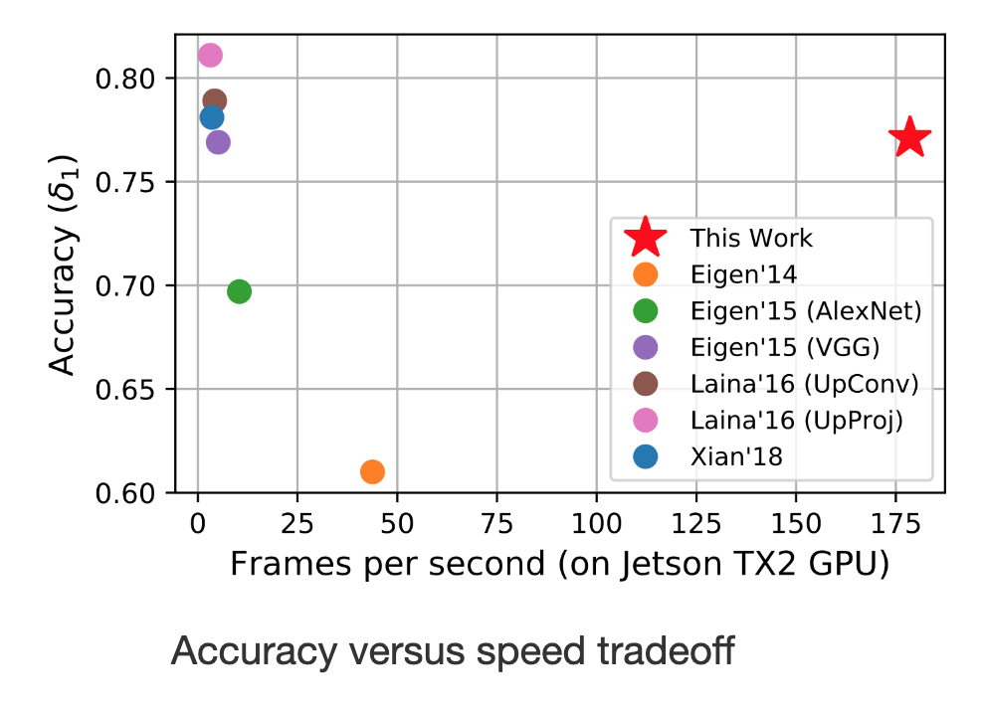
Depth estimation from a single image is a popular research topic in academia
D. Wofk et al.
Notes:
Value in having depth information available immediately for a single image
Triangulation from stereo won’t work and no laser readings are available for standard monocular camera
Learning-based approaches to depth estimation
Avoid sacrificing accuracy for speed
One-shot depth estimation improves SLAM system initialization

Slide 6
Motivation
Background
Methodology
Results
Future Works

Slide 7
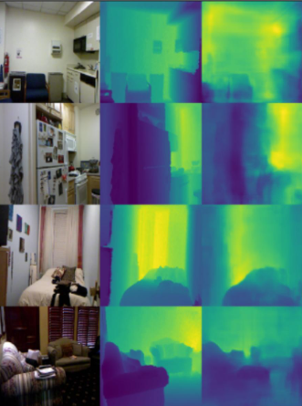
FastDepth is a lightweight, learning based, encoder-decoder network architecture.
RGB input, Depth Ground Truth and Estimated Depth Map using FastDepth on our system
Notes:
Depth Estimation - FastDepth
A lightweight encoder-decoder network architecture
Network pruning to reduce computational complexity and latency
Real-time!

Slide 8
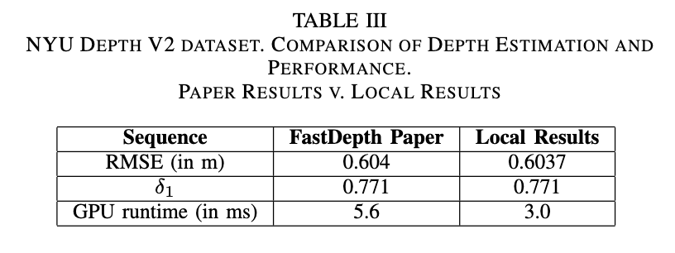
FastDepth is a lightweight, learning based, encoder-decoder network architecture.
RGB input, Depth Ground Truth and Estimated Depth Map using FastDepth on our system
Notes:
Depth Estimation - FastDepth
A lightweight encoder-decoder network architecture
Network pruning to reduce computational complexity and latency
Real-time!

Slide 9
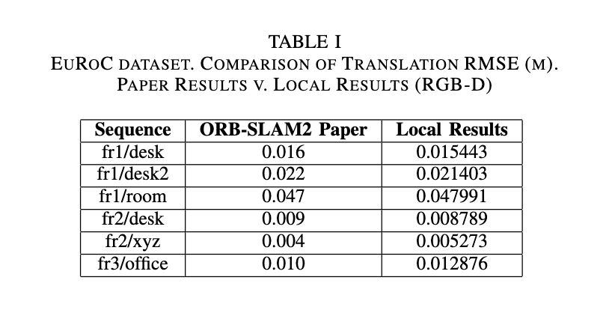
ORB-SLAM2 is a SLAM system for monocular, stereo and RGB-D inputs
Notes:
Depth Estimation - FastDepth
A lightweight encoder-decoder network architecture
Network pruning to reduce computational complexity and latency
Real-time!

Slide 10
Motivation
Background
Methodology
Results
Remaining Work

Slide 11
FastDepth module
ORB-SLAM2 module
RGB & Depth Images
RGB Images
Depth maps
Depth map processing
Notes:
This is an outline of out proposed pipeline.

Slide 12

FastDepth module
RGB Images
Raw RGB Input Images
Notes:
- Start with monocular images

Slide 13
FastDepth module
RGB Images
Estimated Depth Map

Slide 14
Estimated Depth maps
Depth map processing

Slide 15
Estimated depth maps converted to 8-bit greyscale
Depth map processing
Notes:
- Convert those depth maps into 16 bit greyscale images.

Slide 16
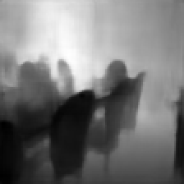
8-bit greyscale converted to 16-bit pixel intensities
Depth map processing

Slide 17
Depth map processing
Depth Images
Pixel intensity of 1 equates to 100 cm.

Slide 18
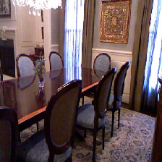
ORB-SLAM2 module
RGB & Depth Images

Slide 19
Motivation
Background
Methodology
Results
Remaining Work

Slide 20
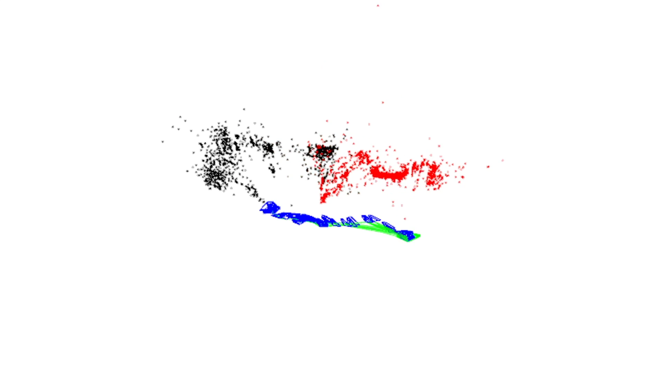
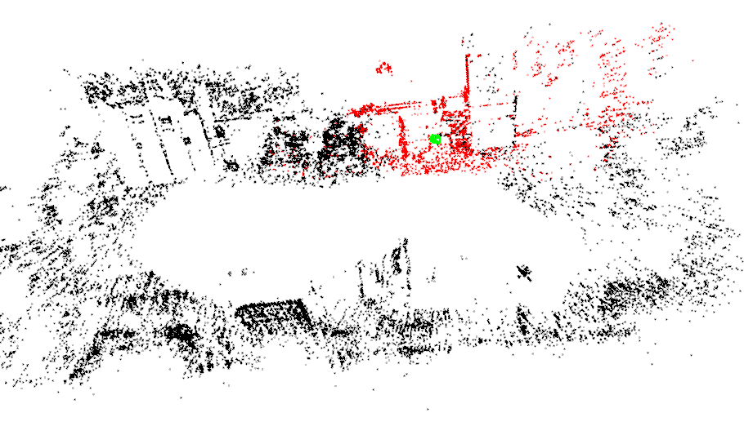
RMSE (m)
Monocular SLAM | RGB-D SLAM w/ FastDepth Estimation | Raw RGB-D SLAM
0.692081 | 0.3555921 | 0.039608

Slide 21
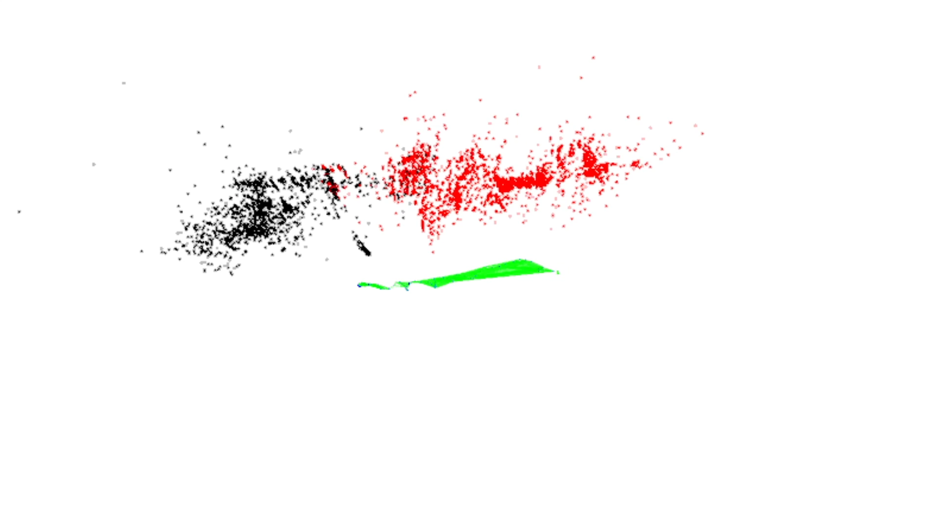
RMSE (m)
Monocular SLAM | RGB-D SLAM w/ FastDepth Estimation | Raw RGB-D SLAM
0.692081 | 0.3555921 | 0.039608

Slide 22
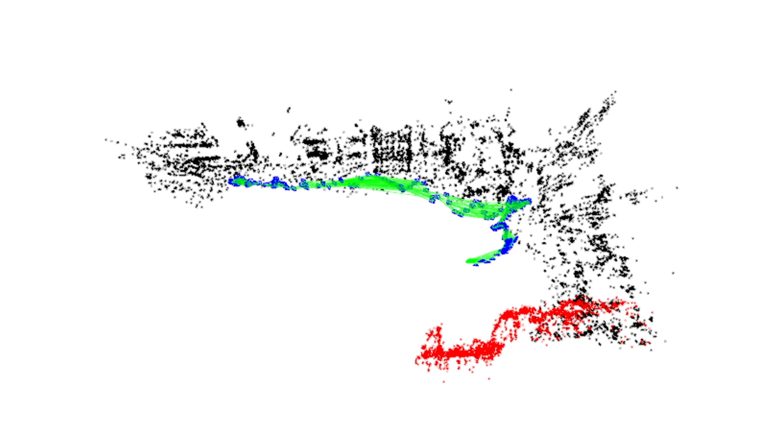
RMSE (m)
Monocular SLAM | RGB-D SLAM w/ FastDepth Estimation | Raw RGB-D SLAM
0.692081 | 0.3555921 | 0.039608

Slide 23
Motivation
Background
Methodology
Results
Remaining Work

Slide 24
Run our system in real-time using FastDepth inference during run time
Notes:
Dramatic lighting - how does the algorithm behave when presented with a bright scene punctuated by deep shadow?
Indoor vs. outdoor - does landmark detection perform better or worse between these settings?
Featureless surfaces - how does the algorithm behave when presented with large, nondescript surfaces such as blank walls?
Intermittent black-outs - how does the algorithm recover from temporary loss of image data?

Slide 25
Collect custom datasets of challenging setting to push our system to the limit
Notes:
Dramatic lighting - how does the algorithm behave when presented with a bright scene punctuated by deep shadow?
Indoor vs. outdoor - does landmark detection perform better or worse between these settings?
Featureless surfaces - how does the algorithm behave when presented with large, nondescript surfaces such as blank walls?
Intermittent black-outs - how does the algorithm recover from temporary loss of image data?

Slide 26
Collect custom datasets of challenging setting to push our system to the limit
Dramatic lighting
Notes:
Dramatic lighting - how does the algorithm behave when presented with a bright scene punctuated by deep shadow?
Indoor vs. outdoor - does landmark detection perform better or worse between these settings?
Featureless surfaces - how does the algorithm behave when presented with large, nondescript surfaces such as blank walls?
Intermittent black-outs - how does the algorithm recover from temporary loss of image data?

Slide 27
Collect custom datasets of challenging setting to push our system to the limit
Dramatic lighting
Indoor vs. outdoor
Notes:
Dramatic lighting - how does the algorithm behave when presented with a bright scene punctuated by deep shadow?
Indoor vs. outdoor - does landmark detection perform better or worse between these settings?
Featureless surfaces - how does the algorithm behave when presented with large, nondescript surfaces such as blank walls?
Intermittent black-outs - how does the algorithm recover from temporary loss of image data?

Slide 28
Collect custom datasets of challenging setting to push our system to the limit
Dramatic lighting
Indoor vs. outdoor
Featureless surfaces
Notes:
Dramatic lighting - how does the algorithm behave when presented with a bright scene punctuated by deep shadow?
Indoor vs. outdoor - does landmark detection perform better or worse between these settings?
Featureless surfaces - how does the algorithm behave when presented with large, nondescript surfaces such as blank walls?
Intermittent black-outs - how does the algorithm recover from temporary loss of image data?

Slide 29
Collect custom datasets of challenging settings to push our system to the limit
Dramatic lighting
Indoor vs. outdoor
Featureless surfaces
Intermittent black-outs
Notes:
Dramatic lighting - how does the algorithm behave when presented with a bright scene punctuated by deep shadow?
Indoor vs. outdoor - does landmark detection perform better or worse between these settings?
Featureless surfaces - how does the algorithm behave when presented with large, nondescript surfaces such as blank walls?
Intermittent black-outs - how does the algorithm recover from temporary loss of image data?

